Slide 1
ROTATING SOLAR PANEL FOR MAXIMUM POWER UTILIZATION
RAMAKANTH
1602-19-733-118
NIKHIL RACHHA
1602-19-733-082

Slide 2
MOTIVATION
Today’s world has increasing demands for energy by the day, which is against the continuous reduction in existing resources of fossil fuels and ever-growing concern regarding environmental pollution that has pushed humans to explore new technologies to produce electrical energy. A prominent non-conventional renewable source of energy is solar energy which provides a good prospect for conversion into electrical power, which in turn ensures a critical part of the electrical needs of the planet

Slide 3
ABSTRACT
The main objective of this project is to harness the maximum amount of sunlight from the sun and convert it to electricity so that it can be easily used and transferred. This is done by aligning the solar panel perpendicular to sun rays to convert maximum sunlight into electrical form.
The advantage of this project is to provide access to everlasting and pollution-free energy. This project can be used in form of decentralized generation.

Slide 4
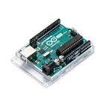

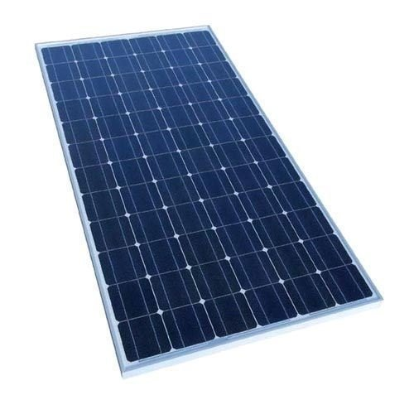
COMPONENTS
1.Arduino UNO
2. Servo Motor
3.Solar Panel

Slide 5
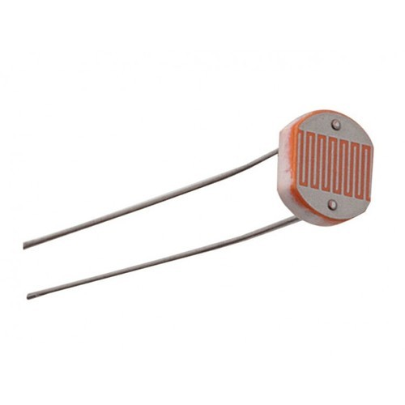

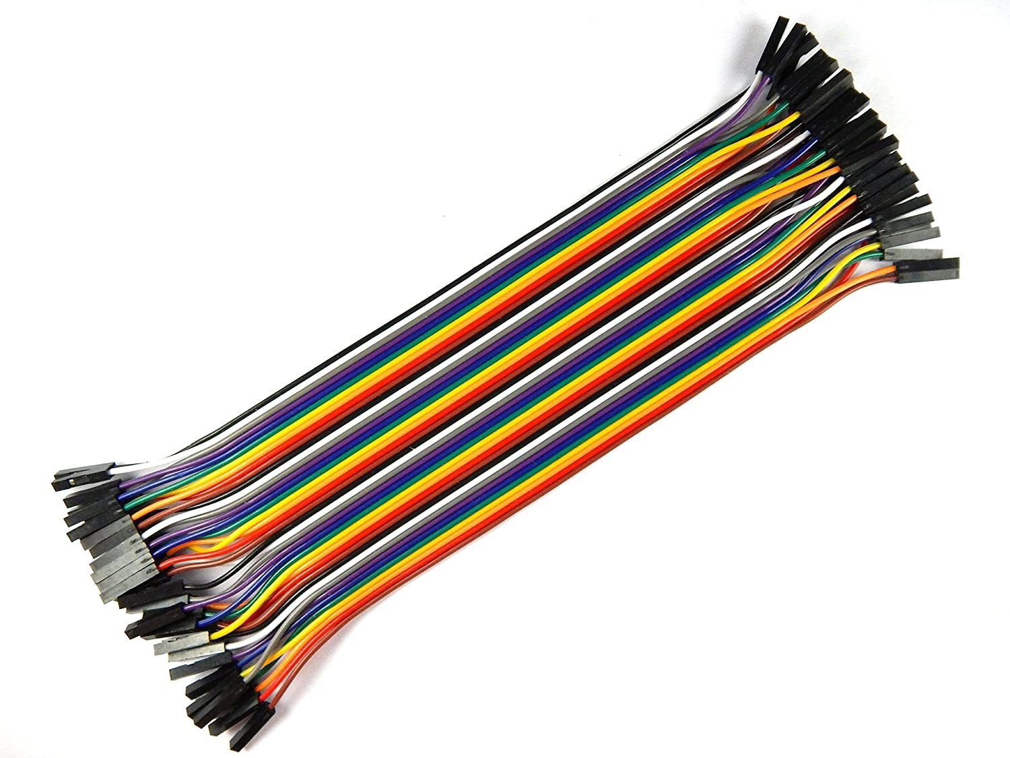
4.LDR Sensor
5.Resistors
6.Jumper Wires

Slide 6
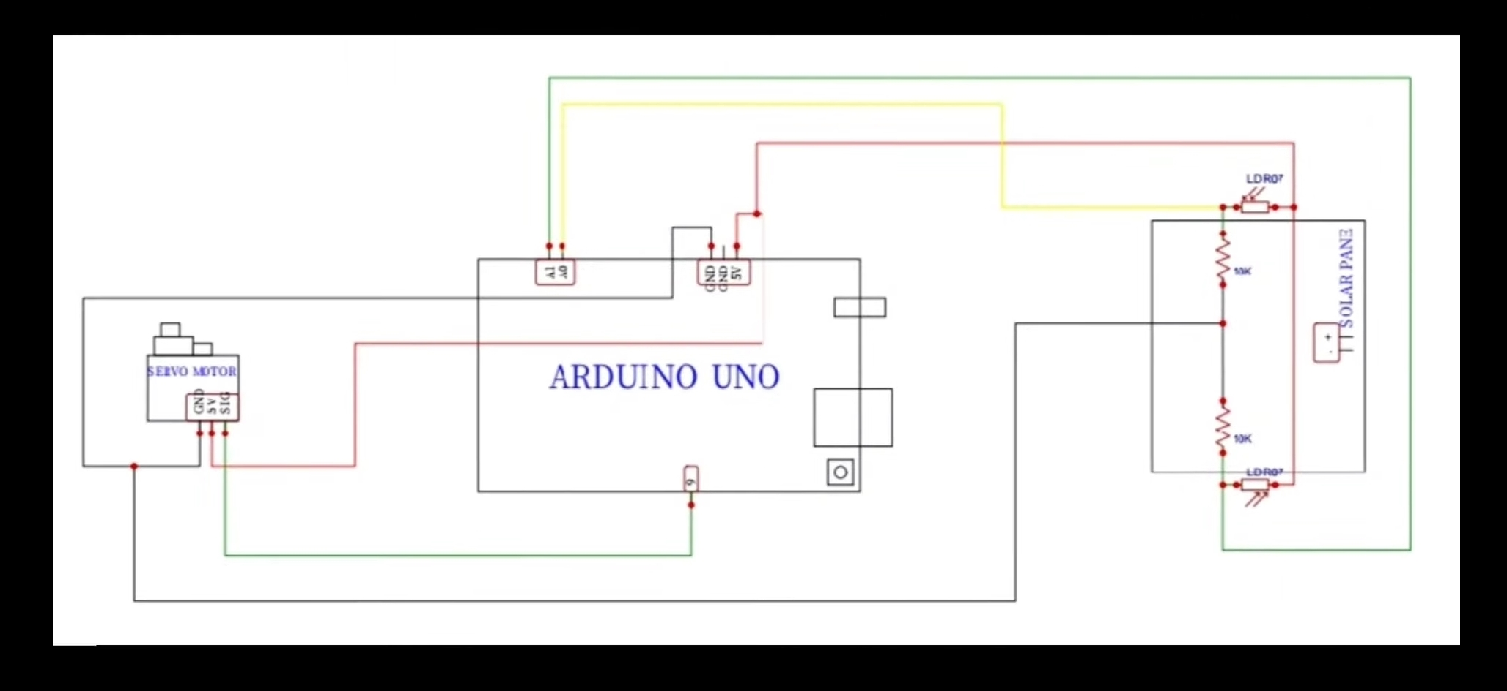
CIRCUIT DIAGRAM

Slide 7
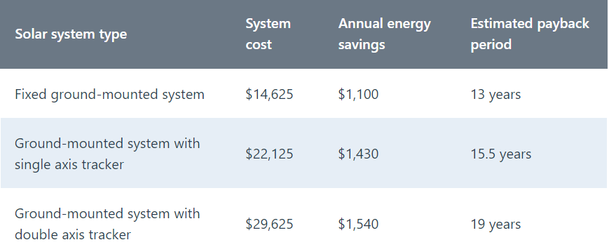
PROTOTYPE PRICING

Slide 8
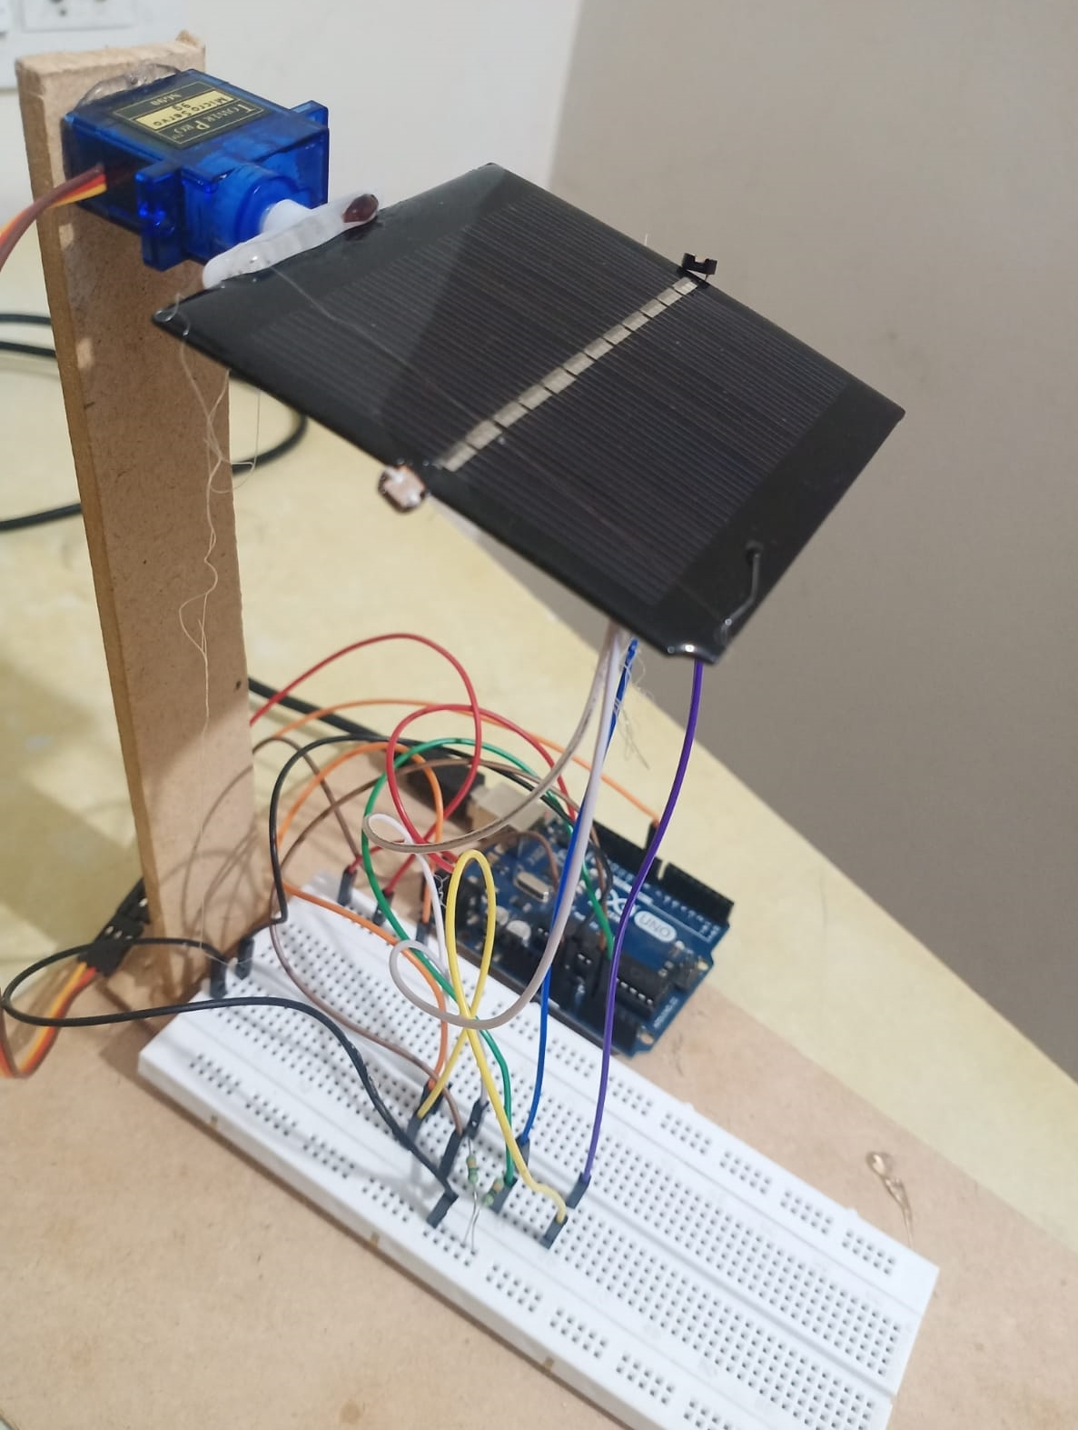
IMPLEMENTATION

Slide 9
THANK YOU

